Slide 1
Electronic Voting
Author:
Michał Rajkowski
Tutor:
prof. dr hab. inż. Zbigniew Kotulski

Slide 2
Agenda
Introduction
Classification
Architecture
Existing e-voting system
Summary

Slide 3
Introduction
Digitalisation of society -> digitalisation of elections
Comfort – voters can cast their votes remotely e.g. via Internet
Efficiency – shorter time needed to calculate election results
Accuracy – much higher compared to standard elections
Cost – ability to reduce election cost in the long run

Slide 4
Classification
You can classify electronic voting system using 2 main criteria:
Degree of digitalisation
Security features

Slide 5
Degree of digitalization
How much the system deviates from the original (physical) form and moves towards entirely virtual election system.
Electronic visualization of election results
Mainly used to gather and display election results
Election process remains the same
Security requirements are very low

Slide 6
Degree of digitalisation
Electronically assisted voting
Computer systems support the collection and counting of votes
Voters cast their votes at polling stations using special terminals (voting machines)
Allows for a gradual process of virtualization choices
Safety requirements are much higher than in the previous case

Slide 7
Degree of digitalisation
Remote voting
Votes shall be cast remotely from any location via a medium that allows such data exchange (e.g. Internet, GSM)
Full virtualization of the election process and the highest safety requirements
It is crucial to implement robust solution to the problem of identification of voters (e.g. qualified signature)

Slide 8
Safety features
Safety features define how secure the system is and if it meets specified requirmenets.
Privacy - No one should be able to determine how any individual voted.
Authentication - Only authorized voters should be able to vote.
Uniqueness - No voter should be able to vote more than once.
Accuracy - Voting systems should record the votes correctly.

Slide 9
Safety features
Verifiability - Should be possible to verify that votes are correctly counted for in the final tally.
Auditability - There should be reliable and demonstrably authentic election records.
Reliability - Systems should work robustly, even in the face of numerous failures.
Non-coercibility -Voters should not be able to prove how they voted.
Integrity - Votes should not be able to be modified without detection.

Slide 10
Safety features
Flexibility - Equipment should allow for a variety of ballot question formats.
Convenience - Voters should be able to cast votes with minimal equipment and skills.
Certifiability - Systems should be testable against essential criteria.
Transparency - Voters should be able to possess a general understanding of the whole process.

Slide 11
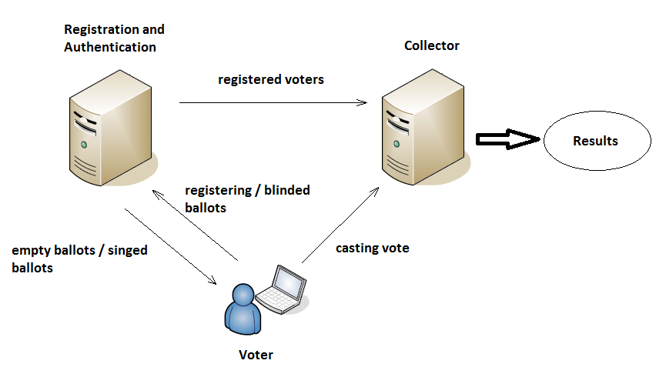
Architecture

Slide 12
Blind signature scheme
Administration

Slide 13
Existing e-voting systems
Some countries are already using e-voting systems:
Australia, Belgium, Brazil, Canada, Estonia, France, Germany, India, Italy, the Netherlands, Norway, Peru, Romania, Switzerland, the United Kingdom and many others
Most notable examples:
USA
Estonia
Not all are successful:
Ireland – system woth €52 million was rejected by Central Election Committee due to the security flaws

Slide 14
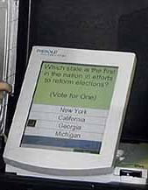
e-Voting in USA
Mostly electronically assisted voting using voting machines
Also called DRE (Direct Recording Systems)
Not yet fully virtual voting
Facing many issues with the equipment/system

Slide 15
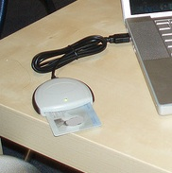
e-Voting in Estonia
Remote voting (via Internet)
First e-elections in 2005
Authentication based on the national ID cards (smart cards)
In 2011 16% of eligible voters casted their votes using e-voting system

Slide 16
Summary
Rising popularity of e-voting systems
Many desirable features that cannot be achived in standard elections
Not always secure (must use trusted system provider)

Slide 17
Questions?

